Slide 1
CS 4350: Fundamentals of Software Engineering Lesson 7.2 Functional Testing
Adeel Bhutta, Frank Tip, Jan Vitek, Mitch Wand
Khoury College of Computer Sciences
© 2021 Released under the CC BY-SA license

Slide 2
Systematic Functional Testing
explores the search space of possible test cases systematically
partition testing: a testing method where:
the input space is separated into “classes” whose union is the entire space
test cases are developed separately for each “class”
functional testing = specification-based partition testing,
i.e., partition testing where the partitions are determined based on a functional specification
Notes:
The term “Systematic Functional Testing” is used to refer to testing techniques that explore the search space of possible test cases systematically
We use the term “Partition Testing” to refer to testing techniques that partition the input space into a set of equivalence classes so that the union of these equivalence classes covers the entire input space.
The term “Functional Testing” is used to refer to techniques for partition testing where the partitions are determined based on a functional specification.

Slide 3


Systematic Functional Testing
identify
Functional specification
Independently testable feature
identify
derive
Representative values
Model
derive
generate
Test case
Test case specifications
The main steps of a systematic approach to functional program testing
(from Pezze + Young, “Software Testing and Analysis”, Chapter 10)
Notes:
This slide visualizes the overall approach of systematic functional testing
As you can see, systematic functional testing involves several steps:
First, we analyze a functional specification to identify features that can be tested independently
Then, for each of these features, we identifying representative values
In addition, it is sometimes possible to derive a model that specifies the behavior of a feature, e.g. using a state machine
Next, from the representative values and the model, we derive a set of test case specifications,
…from which the actual test cases can be generated
We will now consider each of these steps in some detail and give some examples

Slide 4
Testable Features
identify
Functional specification
Independently testable feature
Decompose system into independently testable features (ITF)
An ITF need not correspond to units or subsystems of the software
For system testing, ITFs are exposed through user interfaces or APIs
Notes:
usually functional specifications describe systems that can be decomposed into distinct features that can be tested independently
for example, a specification for a web site may include features for searching the database, registering user profiles, and so on..
the idea is to design test cases so that each feature is tested separately
Note that ITFs generally do not correspond to modules or subsystems.
For system testing, ITFs are typically exposed through user-interfaces or APIs

Slide 5
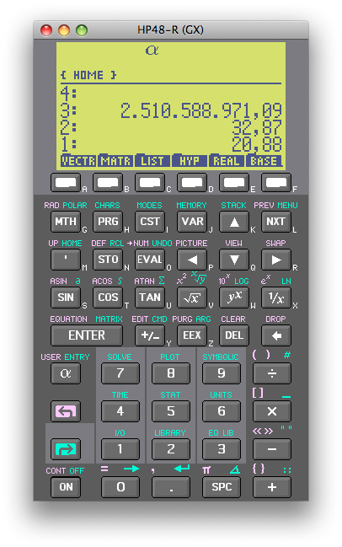
Testable Features
Consider a multi-function calculator
What are the independently testable features?
Notes:
As an example, consider a calculator
Each function that is associated with a button on the calculator corresponds to an independently testable feature.
Note that some functions (like memory access, for instance) are dependent on other functions (to retrieve a value, you must store it first)

Slide 6
Representative Values
Try to select inputs that are especially valuable
Usually by choosing representatives of equivalence classes that are apt to fail often or not at all
Independently testable feature
identify
Representative values
Notes:
The next step is to identify a set of representative values for each ITF
representative values can sometimes be identified directly from informal specifications (for example, if the application supports different types of files, there could be a representative value corresponding to each type of file)
we may also be able to identify different categories of expected values e.g. boundary values or exceptional values
finding suitable representative values is usually done by breaking up the input space into a set of equivalence classes, and selecting representative values in each equivalence class

Slide 7

Needles in a Haystack
To find needles, look systematically
We need to find out what makes needles special
Notes:
You can think of systematic functional testing as a smart way to find needles in a haystack.
We want to search systematically for needles, and to do that we need to understand what makes needles special

Slide 8
Systematic Partition Testing
Failures are sparse in the space of possible inputs ...
Failure (valuable test case)
... but dense in some parts of the space
No failure
The space of possible input values
(the haystack)
If we systematically test some cases from each part, we will include the dense parts
Functional testing is one way of drawing orange lines to isolate regions with likely failures
(from Pezze + Young, “Software Testing and Analysis”, Chapter 10)
Notes:
We can think of all the possible input values to a program as little boxes ... white boxes that the program processes correctly, and colored boxes on which the program fails. Our problem is that there are a lot of boxes ... a huge number, and the colored boxes are just a tiny fraction of the whole set. If we select boxes at random, we are unlikely to find the colored ones. (CLICK)
Moreover, failures are typically concentrated in just a few parts of the input space (CLICK)
Systematic testing says: Let’s not pull them out at random. Let’s first subdivide the big bag of boxes into smaller groups, and do it in a way that tends to concentrate the colored boxes in a few of the groups.
The number of groups needs to be much smaller than the number of boxes, so that we can systematically reach into each group to pick one or a few boxes. (CLICK)
Functional testing is one variety of partition testing, where we rely on the program specification to decide how to draw the lines.

Slide 9
Equivalence Partitioning
Input condition | Equivalence classes
range | one valid, two invalid (larger and smaller)
specific value | one valid, two invalid (larger and smaller)
member of a set | one valid, one invalid
boolean | one valid, one invalid
Notes:
So how do we choose equivalence classes? The key is to identify input conditions from the spec. Each input condition induces an equivalence class – valid and invalid inputs.
For example, an input condition that specifies a range of values induces three equivalence classes: one containing values smaller than the lower bound of the range, one with values within the range, and one containing values larger than the upper bound of the range
Similarly, an input condition that specifies a specific value, …
Likewise, set membership and conditions that correspond to boolean predicates can be represented using two equivalence classes

Slide 10
Boundary Analysis
Possible test case
Test
at lower range
(valid and invalid),
at higher range
(valid and invalid),
and at center
Notes:
How do we choose representatives from equivalence classes?
Typically, a greater number of errors occurs at the boundaries of an equivalence class rather than at the “center”.
Therefore, we specifically look for values that are at the boundaries.
In the example you see here, we could select a value just outside of the lower end of the range, just inside the lower end of the range, …
If your system has well-defined inputs and outputs, you can apply this technique both to the input domain and the output domain.

Slide 11

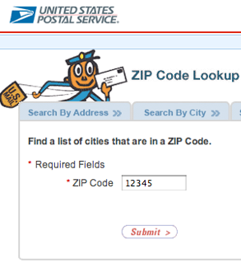
Example: ZIP Code
Input: 5-digit ZIP code
Output: list of cities
What are representative values to test?
(from Pezze + Young, “Software Testing and Analysis”, Chapter 10)
Notes:
For example, let’s consider an application that looks up the cities that are within a given ZIP code.
<…>

Slide 12
Valid ZIP Codes
with 0 cities as output (0 is boundary value)
with 1 city as output
with many cities as output
Notes:
So, in this case you can pick valid inputs that have 5 digits and for which there are
0 cities as output
1 city as output
many cities as output

Slide 13
Invalid ZIP Codes
empty input
1–4 characters (4 is boundary value)
6 characters (6 is boundary value)
very long input
no digits
non-character data
Notes:
We should also try to create tests that try using invalid ZIP codes
For example, we could create a test that uses an empty input
or given that the expected input is 5 digits, we can try inputs that are too short, or too long, or that contain non-numeric data

Slide 14
“Special” ZIP Codes
How about a ZIP code that reads 12345‘; DROP TABLE orders; SELECT * FROM zipcodes WHERE ‘zip’ = ‘
This is security testing
Notes:
Finally, if we’re interested in the security of our application, we can try creating inputs that might exploit an injection vulnerability.
<..>

Slide 15
Model-Based Testing
Independently testable feature
Have a formal model that specifies software behavior
Models typically come as
finite state machines and
decision structures
derive
Model
Notes:
Models of application behavior may also be helpful in functional testing.
These usually take one of two forms: finite state machines or decision structures

Slide 16

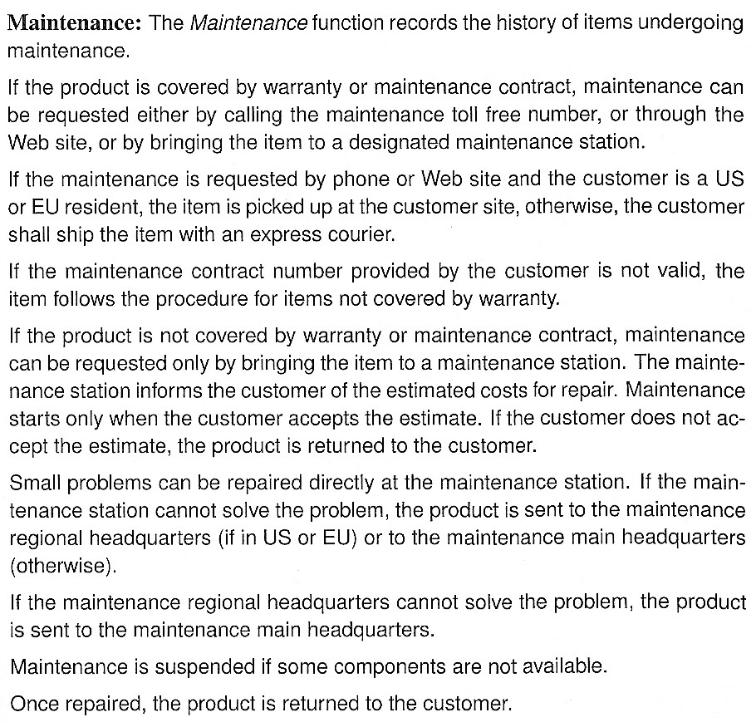
(from Pezze + Young, “Software Testing and Analysis”, Chapter 14)
Notes:
For example, let’s say that we have these (informal) requirements for modeling a product maintenance process…
I suggest that you pause the recording for a minute so that you can read this text.

Slide 17
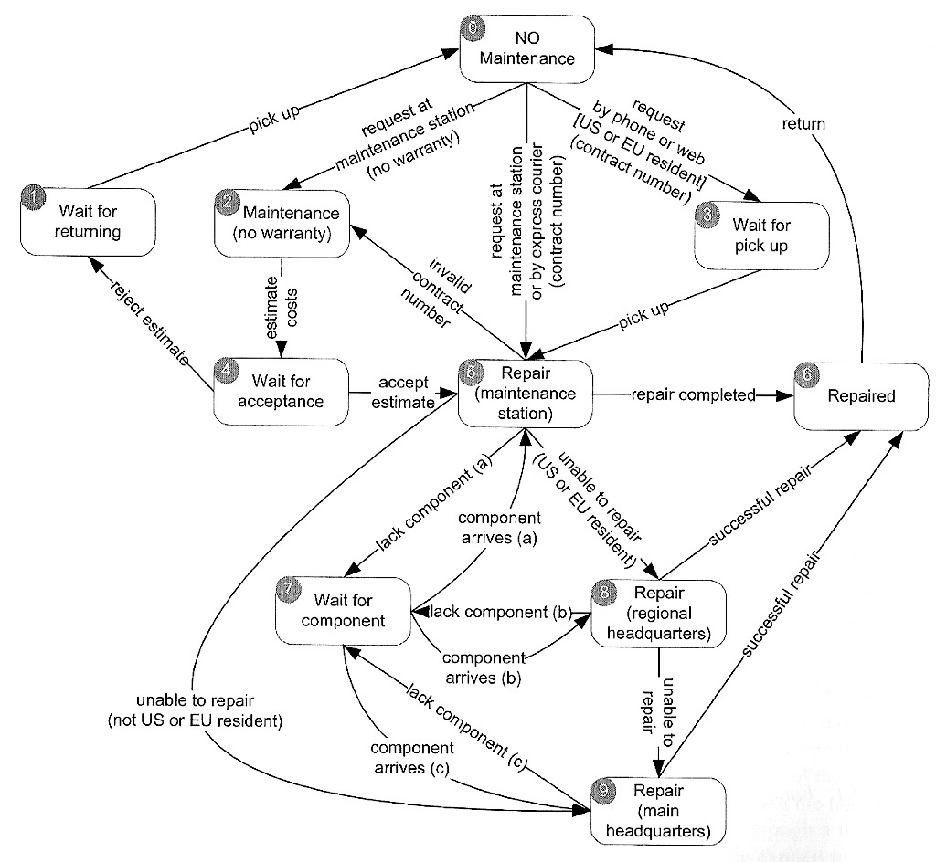
Finite State Machine
0
1
2
3
4
5
6
7
8
9
(from Pezze + Young, “Software Testing and Analysis”, Chapter 10)
Notes:
Now that we’ve examined the specification carefully, we conclude that these steps in the maintenance process can be encoded in a Finite State Machine as follows

Slide 18
Coverage Criteria
Path coverage: Tests cover every path Not feasible in practice due to infinite number of paths
State coverage: Every node is executed A minimum testing criterion
Transition coverage: Every edge is executed Typically, a good coverage criterion to aim for
Notes:
Given such a finite state machine, we can construct a set of tests that aim to “cover” the Finite State Machine systematically
We distinguish three types of coverage: <…>
Note: we are talking about coverage of the model (state machine) here; we’ll be talking about code coverage later

Slide 19
Transition Coverage
0
1
2
3
4
5
6
7
8
9
(from Pezze + Young, “Software Testing and Analysis”, Chapter 14)
Notes:
In the case of this example, it is possible to define 5 test cases that correspond to different paths through the state machine.
Here, each of these paths is shown in a different color.
As you can see, together, these tests cover each transition in the state machine.
While this example is somewhat artificial, you can probably imagine that state machines can be useful for describing the behavior of Protocols (e.g., network communication) and GUIs (sequences of interactions)

Slide 20
State-Based Testing
Protocols (e.g., network communication)
GUIs (sequences of interactions)
Objects (methods and states)
Notes:
Finite state machines can be used to model a large variety of behaviors, such as protocols, GUIs, and objects.

Slide 21
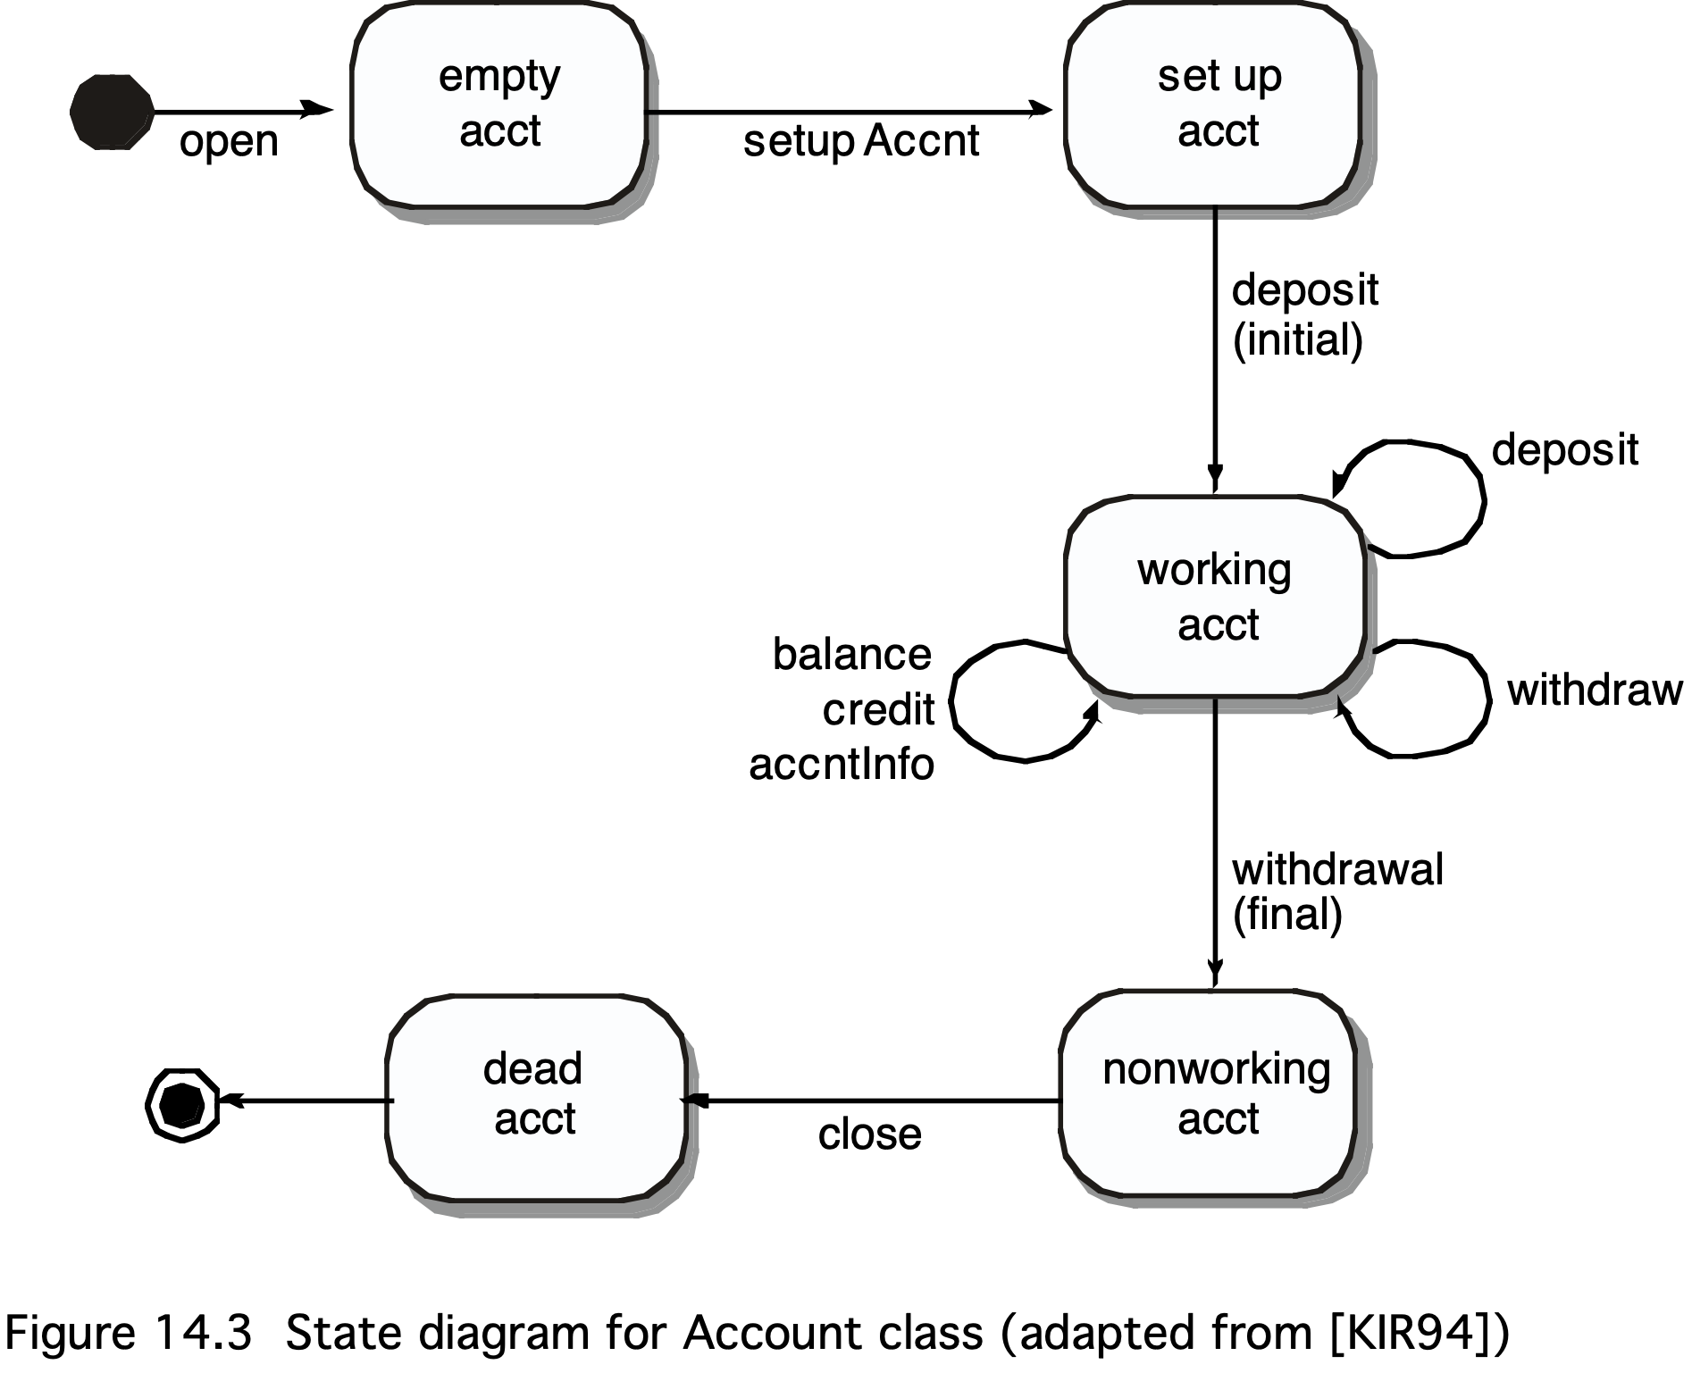
Account States
Notes:
Here’s an example of a finite state machine representing an Account class going through a number of states. Transition coverage means testing each Account method once.
(From Pressman, “Software Engineering – a practitioner’s approach”, Chapter 14)

Slide 22
Example: Discounts
from Pezze + Young, “Software Testing and Analysis”, Chapter 14
Notes:
To illustrate how decision diagrams can be used for model-based testing, consider the following specification, which specifies how prices are computed for various types of customers who are eligible for different discounts.
I suggest you pause the recording for a minute to read the text, and focus on how prices are computed for customers with education accounts

Slide 23
Decision Tables
 | Education |  | Individual
Education account | T | T | F | F | F | F | F | F
Current purchase > Threshold 1 | – | – | F | F | T | T | – | –
Current purchase > Threshold 2 | – | – | – | – | F | F | T | T
Special price < scheduled price | F | T | F | T | – | – | – | –
Special price < Tier 1 | – | – | – | – | F | T | – | –
Special price < Tier 2 | – | – | – | – | – | – | F | T
Out | Edu discount | Special price | No discount | Special price | Tier 1 discount | Special price | Tier 2 discount | Special Price
(from Pezze + Young, “Software Testing and Analysis”, Chapter 14)
Notes:
This slides shows a decision table that captures the pricing policy from the previous specification
A decision table describes under which conditions a specific outcome is computed.
This decision table determines the discount for a purchase, depending on specific thresholds for the amount purchased.
You can see that there are two scenarios for education accounts. A special price is offered if it is less than the regular scheduled price. Otherwise, the educational discount applies.
From a decision table, tests can be generated in various ways. One obvious approach is to generate one test for each column in the table.

Slide 24
Condition Coverage
Basic criterion: Test every column
“Don’t care” entries (–) can take arbitrary values
Compound criterion: Test every combination
Requires 2^{n} tests for n conditions and is unrealistic
Modified Condition Decision Criterion (MCDC): like basic criterion, but additionally, modify each T/F value at least once

Slide 25
MCDC Coverage
each column in the table represents a test case
create new test cases by varying one value
if the resulting column matches an existing column, merge the generated test case with the one for that column
otherwise, it becomes a new test case
applying this approach to our example yields 78 new columns
21 of which can be merged with columns already in the table
Notes:
see p.255 in Pezze/Young book

Slide 26
MCDC Criterion
 | Education |  | Individual
Education account | T | T | F | F | F | F | F | F
Current purchase > Threshold 1 | – | – | F | F | T | T | – | –
Current purchase > Threshold 2 | – | – | – | – | F | F | T | T
Special price < scheduled price | F | T | F | T | – | – | – | –
Special price < Tier 1 | – | – | – | – | F | T | – | –
Special price < Tier 2 | – | – | – | – | – | – | F | T
Out | Edu discount | Special price | No discount | Special price | Tier 1 discount | Special price | Tier 2 discount | Special Price
F
Notes:
We modify the individual values in column 1 and 2 to generate four additional test cases – but these are already tested anyway. For instance, the modified values in column 1 are already tested in column 3.
(from Pezze + Young, “Software Testing and Analysis”, Chapter 14)

Slide 27
MCDC Criterion
 | Education |  | Individual
Education account | T | T | F | F | F | F | F | F
Current purchase > Threshold 1 | – | – | F | F | T | T | – | –
Current purchase > Threshold 2 | – | – | – | – | F | F | T | T
Special price < scheduled price | F | T | F | T | – | – | – | –
Special price < Tier 1 | – | – | – | – | F | T | – | –
Special price < Tier 2 | – | – | – | – | – | – | F | T
Out | Edu discount | Special price | No discount | Special price | Tier 1 discount | Special price | Tier 2 discount | Special Price
T
Notes:
This also applies to changing the other values, so adding additional test cases is not necessary in this case.
(from Pezze + Young, “Software Testing and Analysis”, Chapter 14)

Slide 28
MCDC Criterion
 | Education |  | Individual
Education account | T | T | F | F | F | F | F | F
Current purchase > Threshold 1 | – | – | F | F | T | T | – | –
Current purchase > Threshold 2 | – | – | – | – | F | F | T | T
Special price < scheduled price | F | T | F | T | – | – | – | –
Special price < Tier 1 | – | – | – | – | F | T | – | –
Special price < Tier 2 | – | – | – | – | – | – | F | T
Out | Edu discount | Special price | No discount | Special price | Tier 1 discount | Special price | Tier 2 discount | Special Price
F

Slide 29
MCDC Criterion
 | Education |  | Individual
Education account | T | T | F | F | F | F | F | F
Current purchase > Threshold 1 | – | – | F | F | T | T | – | –
Current purchase > Threshold 2 | – | – | – | – | F | F | T | T
Special price < scheduled price | F | T | F | T | – | – | – | –
Special price < Tier 1 | – | – | – | – | F | T | – | –
Special price < Tier 2 | – | – | – | – | – | – | F | T
Out | Edu discount | Special price | No discount | Special price | Tier 1 discount | Special price | Tier 2 discount | Special Price
F
Notes:
However, if we had not (yet) tested the individual accounts, the MC/DC criterion would have uncovered them.
(from Pezze + Young, “Software Testing and Analysis”, Chapter 14)

Slide 30
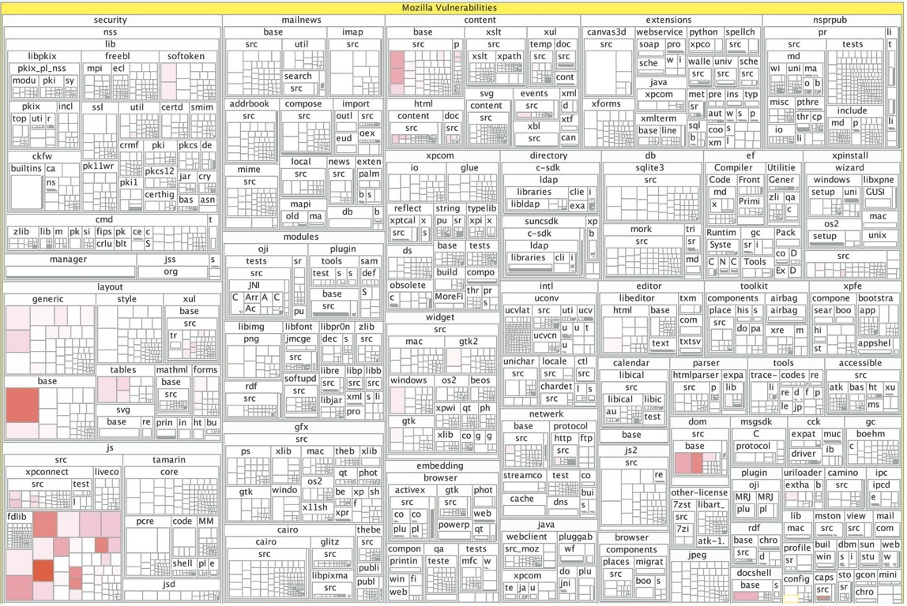
Learning from the Past
Notes:
To decide where to put most effort in testing, one can also examine the project history – i.e., where did most defects occur in the past.
This picture shows the distribution of security vulnerabilities in Firefox – the redder a rectangle, the more vulnerabilities, and therefore a likely candidate for intensive testing.
Andreas Zeller’s group at Saarland University researches how to mine such information automatically in order to predict future defects. This can be used to decide where testing efforts should be focused

Slide 31

Pareto’s Law
Approximately 80% of defects come from 20% of modules
Notes:
The diagram on the previous slide relates to a principle coined by the Italian economist Vilfredo Pareto in the year 1896 that says “roughly 80% of consequences come from 20% of the causes”
In the scenario of software engineering, Pareto’s Law can be interpreted to say that approximately 80% of defects originates from 20% of modules

Slide 32
Deriving Test Case Specs
Input values enumerated in previous step
Now: need to take care of combinations
Typically, one uses models and representative values to generate test cases
Representative values
Model
derive
Test case specifications
Notes:
The next step in the process of Systematic Functional Testing is to derive Test Case Specifications.
Here, representative values and models are used to generate test case specifications.

Slide 33
Combinatorial Testing
Server
OS
Database

Slide 34
Combinatorial Testing
Eliminate invalid combinations
IIS only runs on Windows, for example
Cover all pairs of combinations
such as MySQL on Windows and Linux
Combinations typically generated automatically
and – hopefully – tested automatically, too

Slide 35
Pairwise Testing
Notes:
Pairwise testing means to cover every single pair of configurations
e.g., MySQL on Windows and Linux, Oracle on Windows and Linux

Slide 36
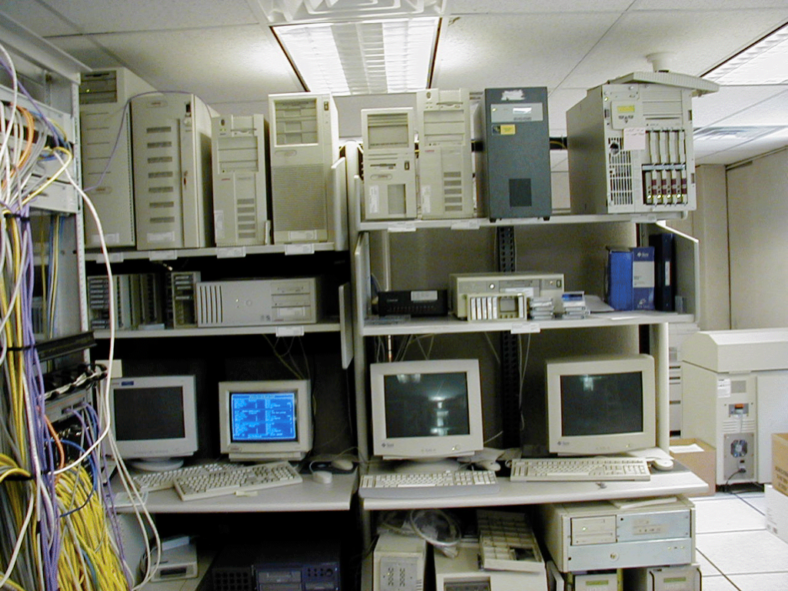
Testing Environment
Millions of configurations
Testing on dozens of different machines
All needed to find & reproduce problems
Millions of configurations
Testing on dozens of different machines
All needed to find & reproduce problems
Notes:
In practice, such testing needs hundreds and hundreds of PCs in every possible configuration – Microsoft, for instance, has entire buildings filled with every hardware imaginable Source: http://www.ci.newton.ma.us/MIS/Network.htm

Slide 37
Deriving Test Cases
Implement test cases in code
Requires building scaffolding – i.e., drivers and stubs
Test case
Test case specifications
Notes:
The final step consists of deriving actual test cases from test case specifications
This involves adding the drivers and stubs that are needed to execute the test cases.

Slide 38
Unit Tests
Directly access units (= classes, modules, components…) at their programming interfaces
Encapsulate a set of tests as a single syntactical unit
Available for all programming languages (JUNIT for Java, CPPUNIT for C++, Mocha for TypeScript and JavaScript, etc.)

Slide 39
Recap: Systematic Functional Testing
identify
Functional specification
Independently testable feature
identify
derive
Representative values
Model
derive
generate
Test case
Test case specifications
The main steps of a systematic approach to functional program testing
(from Pezze + Young, “Software Testing and Analysis”, Chapter 10)
Notes:
The main steps of a systematic approach to functional program testing
(from Pezze + Young, “Software Testing and Analysis”, Chapter 10)

Slide 40

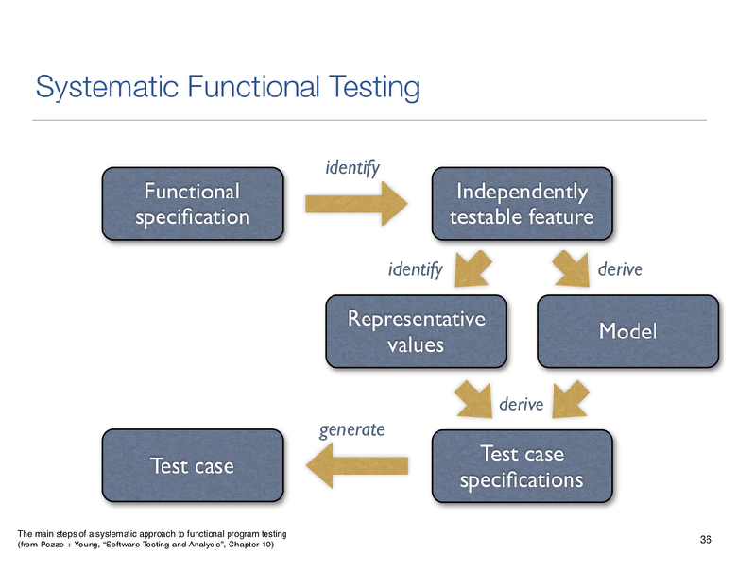
Summary
Notes:
In summary, we have learned about Systematic Functional Testing. This involves:
analyzing a functional specification to identify ITFs
then, for each ITF we identify representative values and optionally a model
Next, from the representative values and the model, we derive a set of test case specifications, …from which the actual test cases can be generated
This concludes our lesson on Functional Testing. In the next Lessons, we will look at Structural Testing techniques

